Slide 1
Home Credit Default Risk
Group-7
Krishna Chaitanya
Anukriti Raj
Shivi Shrivastav
Litzy Carbajal

Slide 2

Overview
Business Problem
Understanding the Data
Proposed Solution
Model Results
Business Impact

Slide 3

Business Problem
Helping unbanked population
Providing positive borrowing experience
Reducing loan rejections for worthy individuals
Improving loan repayment rates

Slide 4

Proposed Solution
Develop a predictive analytical model
Factors influencing client defaulting
Tell whether a client is likely to default or not

Slide 5
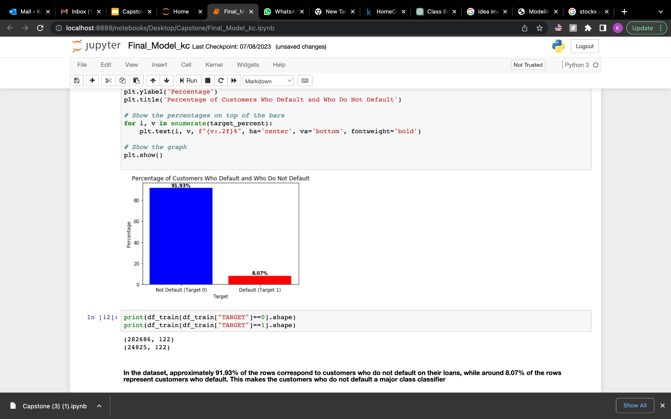
Understanding the Data
Non-defaulters are in majority
Focus on defaulters

Slide 6
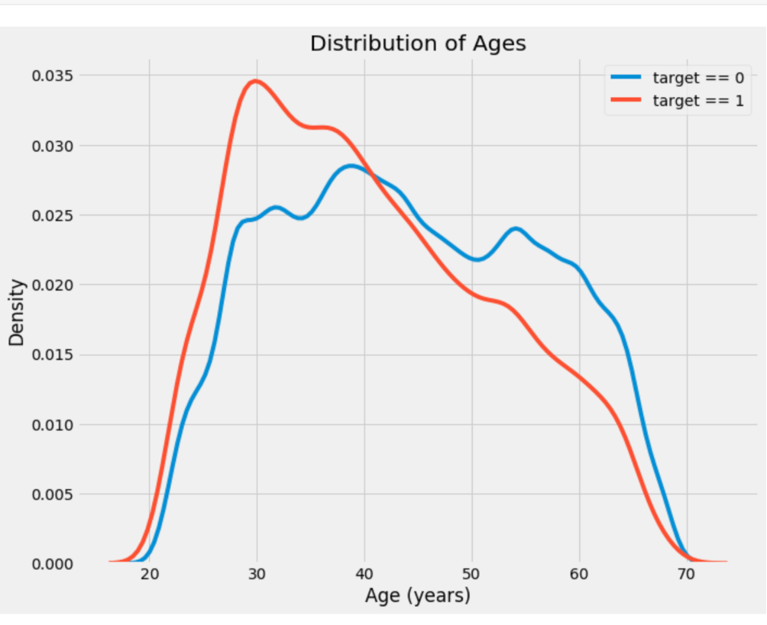
Age group 25 to 30 most likely to default

Slide 7
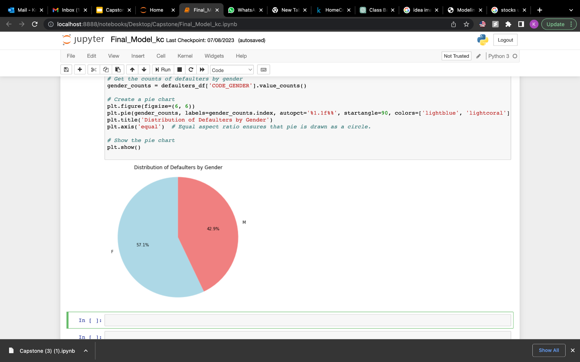
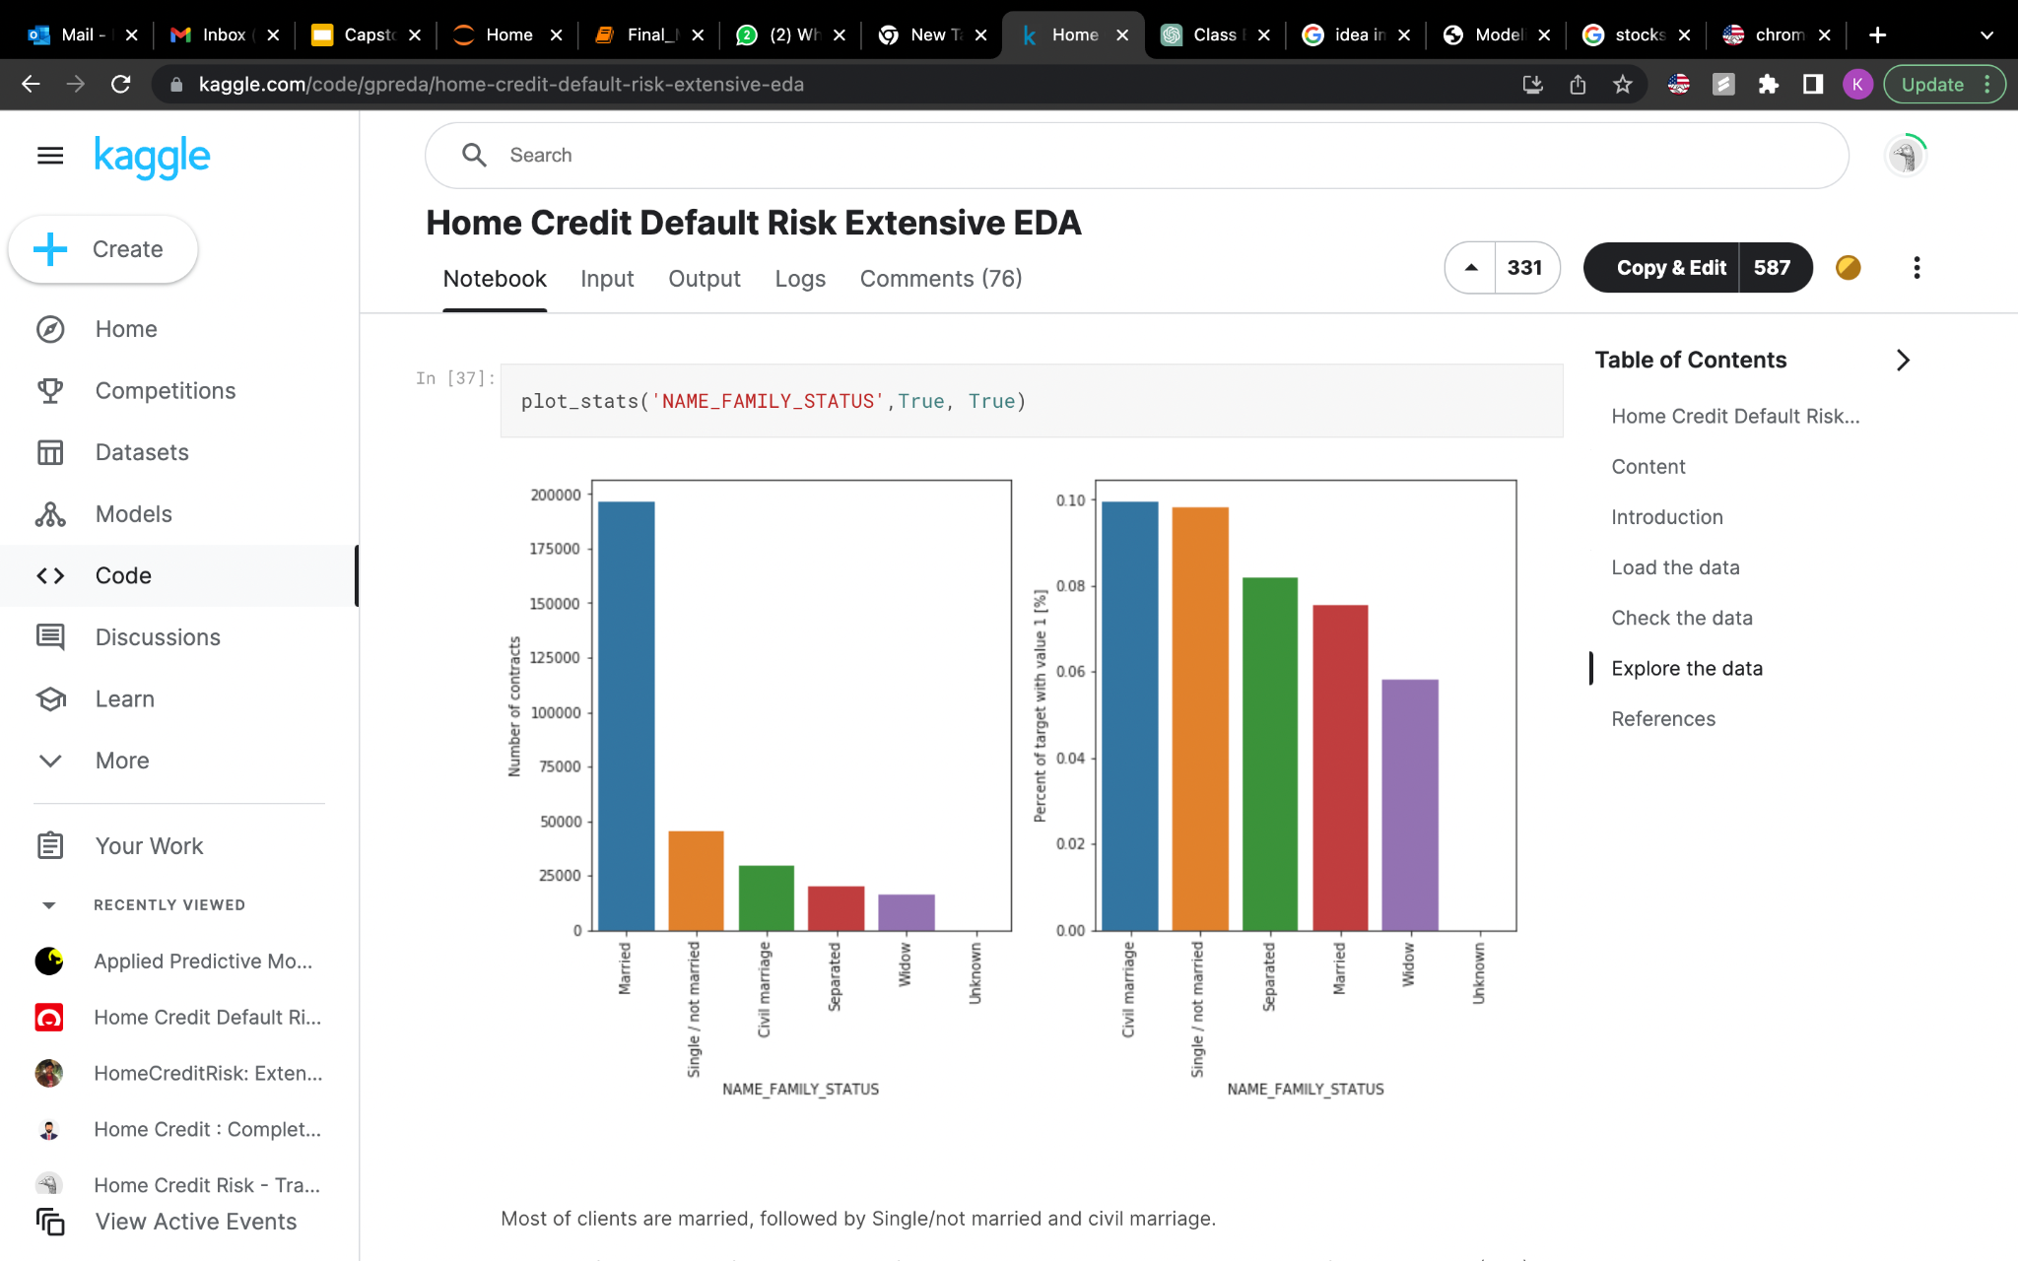
57.1% female stand in majority went default
Civil marriage and Single clients tend to default

Slide 8
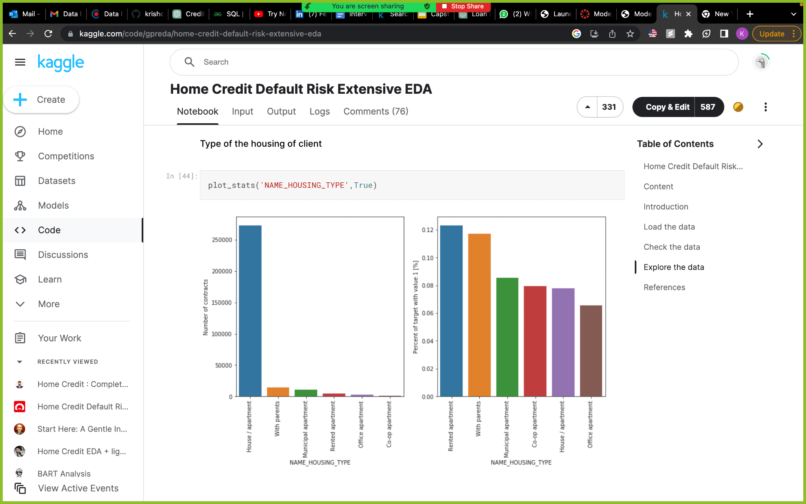
Customers in rented apartments / living with parents are more likely to default.

Slide 9
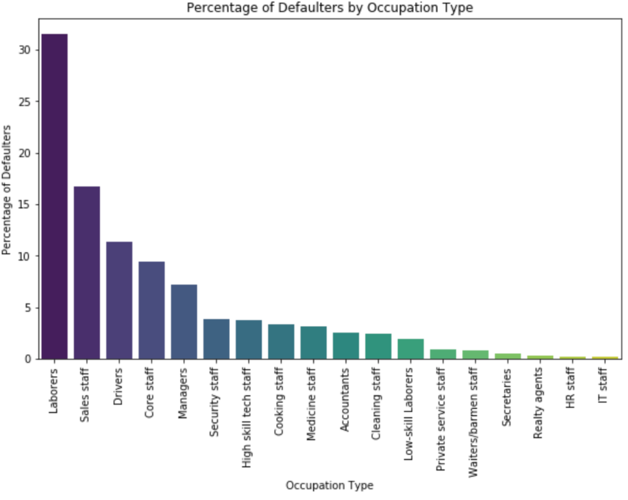
Data shows that laborers and sales staff are the major occupations that go default

Slide 10
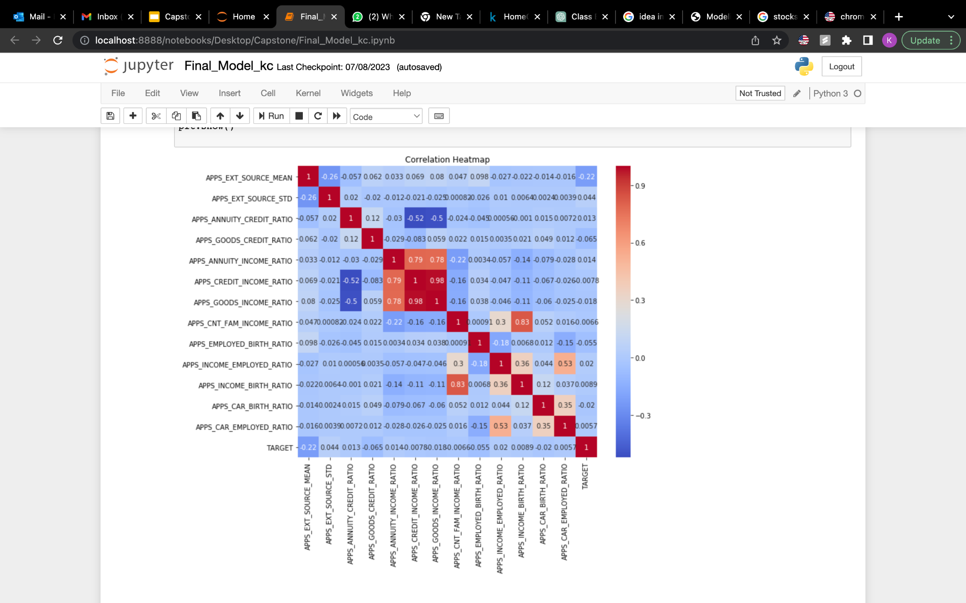
Added new features for the model to predict better

Slide 11
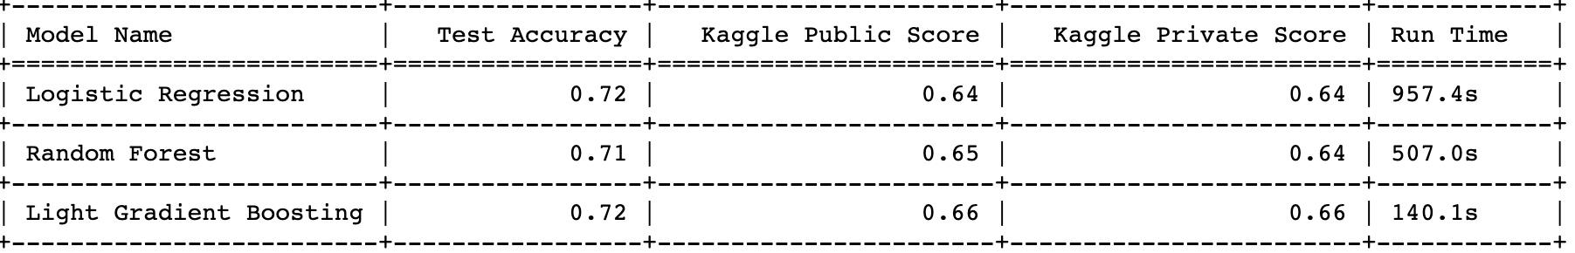
Model Results
LightGBM model for classification
Best Accuracy and Run time

Slide 12
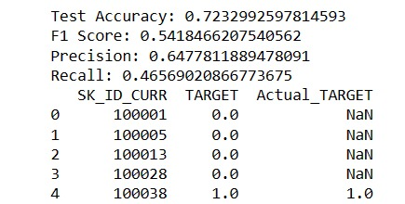
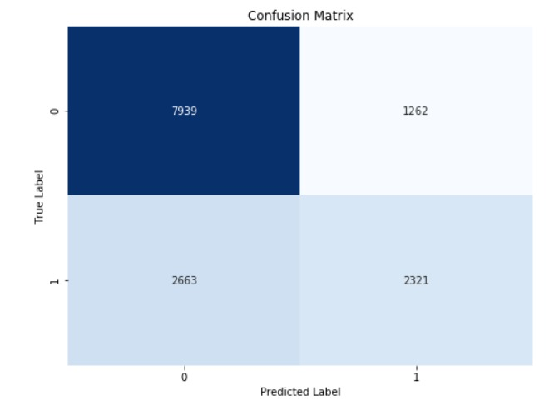
2321 correctly predicted as defaulting
7939 correctly predicted as non defaulting

Slide 13
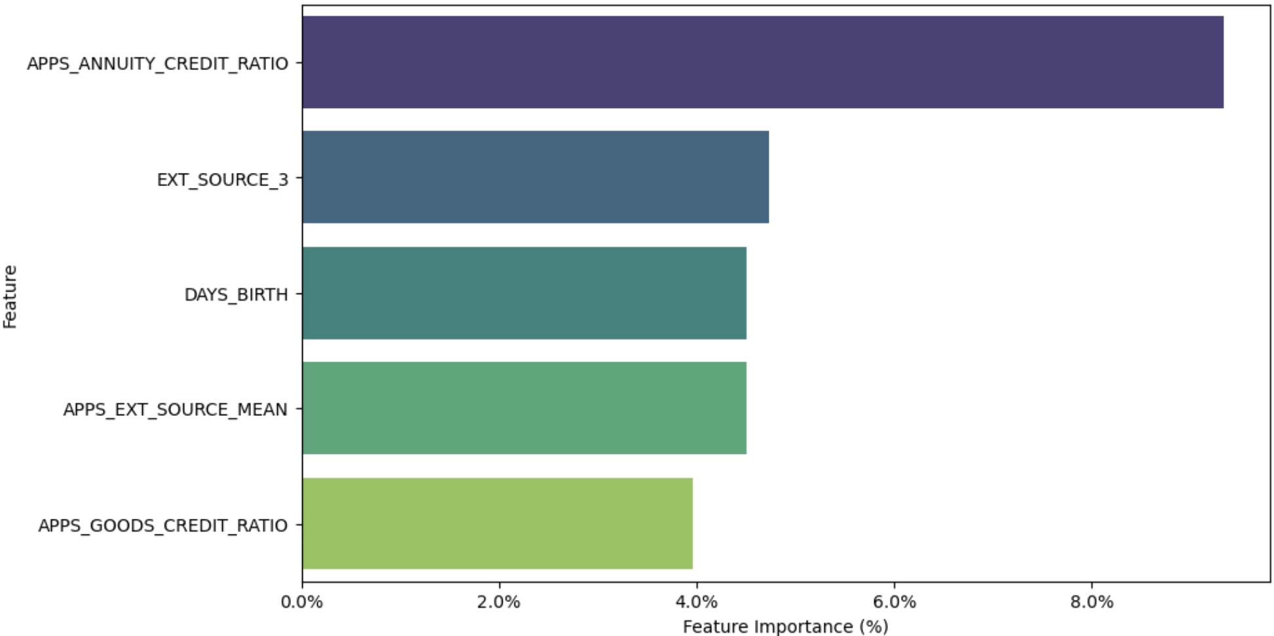
Feature Importance

Slide 14

Business Impact
Reduced defaults.
Minimized losses.
Better risk management.
Balanced loan portfolio.
Increased interest income from on-time repayments.

Slide 15

Questions?

